Slide 1
RGB COLOR SENSOR PROJECT Team Sagittarius
Progress and summary until week 2

Slide 2
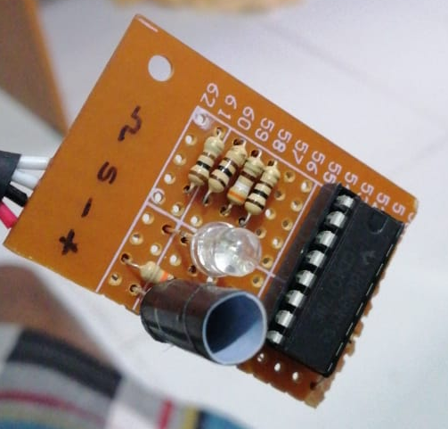
Two basic ideas for the sensing part
Using one LDR & RGB LED
(Later found out as not the best method)
RBG LED
Idea was that object of a given color X, reflects most of the X color light while absorbing most of the other colors.
Therefore, if we can detect the amount of reflection for each Red, Green and Blue light we can roughly estimate the color-composition of the given object.
LDR
(covered to avoid background noise)
But practically, even with proper calibration we were not able to detect some reddish-colors (pink, orange) in an appreciable manner. So, we sticked to our next idea.

Slide 3
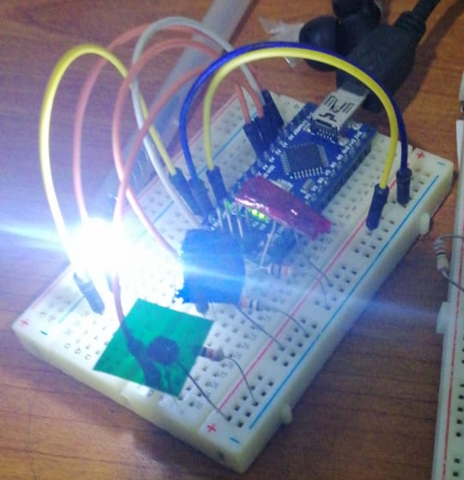
Two basic ideas for the sensing part (contd.)
Using one white LED and 3 LDRs with RBG filters
(Selected to implement, because results were accurate enough!)
Each color filter lets pass only one main color (R,G or B).Therefore, using each LDRs resistance values at a given time we can measure
the amount of each color reflected from the object.
After experimenting with several calibration procedures, we could detect both primary colors and secondary colors accurately.
White LED
By visualizing the almost equal color of the object (on the screen), we verified that the sensor is working correctly.
LDR with
Red filter
LDR with
Green filter
LDR with
Blue filter

Slide 4
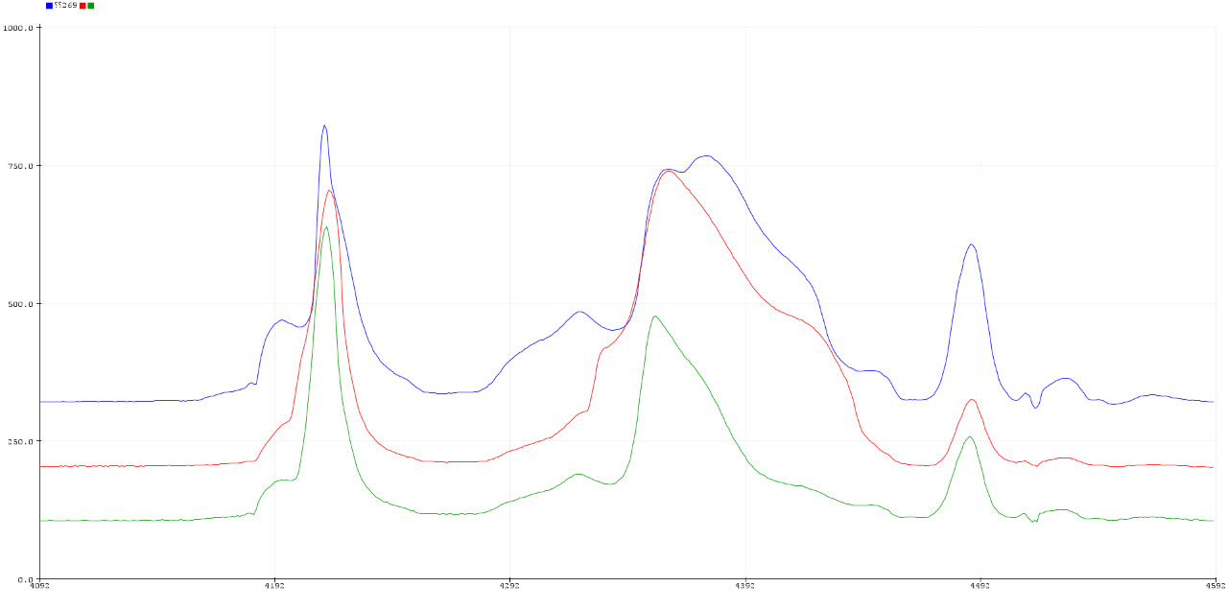
Problems came on the way
Here we are focused on the problems we experienced in the selected prototype
Filters used for each LDR was not doing the filtering process equally
(The amount of passing of light per each color in each filter was different due to selecting various materials
and thicknesses of filters.)
We are experimenting for a proper filter
material and accurate calibration technique.

Slide 5
Problems came on the way (Contd.)
Limited number of available pins
To connect the keypad, we had to use 7 pins leaving us only one pin for other tasks
Using resistors and implementing another circuit we were able to connect keypad with only one analog pin
To connect the display , we wanted 7 more pins
Using I2C or SPI protocols to minimize the pins required.

Slide 6
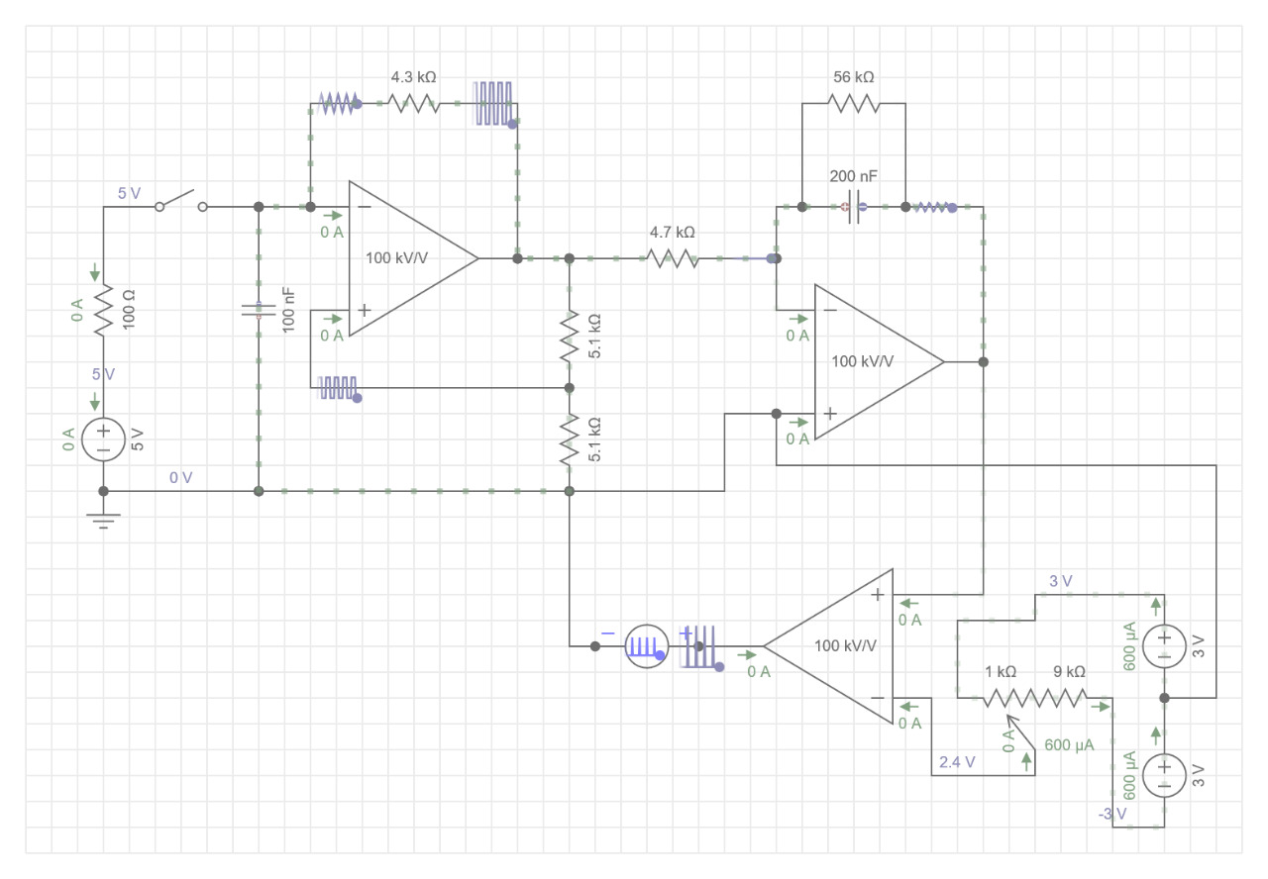
Using only one PWM pin to control the OUTPUT LED was a requirement.
We used a CD4017 to switch between RGBs at 1kHz frequency. And we changed the PWM synchronously.
We used a separate circuit for generate PWM.

Slide 7
Problems came on the way (Contd.)
The distance from the sensor to the object affect the RGB values
We have two possible solutions.
Making the enclosure to have a fixed distance between sensor and object
Using proximity sensor and program it to measure the distance and re-scale
the RBG values

Slide 8
Thank You!

